Slide 1


Analysis of Olympics Data
By - Vineet Kapoor(11910076)
ISB CBA Practicum
23rd September , 2018

Slide 2
Table Of Contents
Executive Summary
Business Problem
Introduction
Motivation For Study
Methodology & Tools
Models
Means
Analytics Approach
Connecting CBA Term – 2 courses
Data collection & cleaning
Data Understanding

Slide 3
Data Preparation
Data Understanding
Modelling & Evaluation
Business Recommendation
Assumptions, Limitations.
References.

Slide 4
Executive Summary
There exist a strong correlation between Olympics performance with Nominal GDP, Number of internet users, country is host or not.
Gender Gap index and Population of a country is correlated to some extent with the count of total medals.
Countries like US bag more medals in Swimming due to height of their players.
Nominal GDP is responsible for good performance of Russia , Australia, Germany, Great Britain and France in Olympics.
The host country has good performance in Olympics.
China’s population and it’s sports culture, sports schools, sports trainees are responsible for it’s good performance.
The individual sports like Badminton, Wresting are the prime sports for India in Olympics.

Slide 5
Methodology and Tools
Step 1
Step 2
Step 3
The data has been filtered out for only those players , who have won medals in the original given dataset. The data is cleaned and all the missing values has been imputed. An additional data using GDP , population and total number of medals was also used for clustering and analysis is performed.
The Dataset for regression has been taken from Wikipedia, economic freedom index site, World Bank, Gender gap index.
Data was collected for top 20 countries in 2016 summer Olympics and India also.
Two datasets are used for analysis. The dataset used for clustering was cleaned. Missing values were imputed by their mean values. Dataset used for Regression analysis is created using the information from the Wikipedia and sites. Total number of medals for top 20 countries in Olympics 2020 are predicted
Step 4
Step 5
Step 6
K- Means Clustering has been performed on the age, weight and height variables for summer and winter seasons. and on whole data
K- Means Clustering has been performed on the age, weight and height variables
Methods used for performing regression models are
Ordinary Least Squares
2. Random Forest.
Gradient Boosting Regressor .
K Nearest Neighbours regressor.
Optimization of Hyperparameters is also performed using Grid Search CV method.
The training and validation data was created using sampling and K- fold cross validation. The whole modelling exercise is done on python using sklearn package.

Slide 6
Business Problem
Which countries dominate in Olympics and why?
To Analyse different countries on the basis of Age, Height and Weight. of players, who won the medals for all seasons
To Cluster different countries on the basis of Age, Height and Weight. of players, who won the medals for Summer and Winter seasons.
To Cluster different countries on the basis of GDP, population and total medals.
Identify the factors that are driving India behind other countries.
Predicting the rank or performance of top 20 countries in next Olympics.

Slide 7
Introduction
Olympics event is held every four years, where different teams participate across the world. In this project, clustering and different regression techniques have been used to solve out important questions related to the performance of players of best performing countries and it is compared with the India’s performance in Olympics.

Slide 8
Motivation For Study
The prediction of total medals from regression and other models can be used for building a predictive model . The K- fold cross validation and comparison of RMSE can improve the accuracy of the model.
The K – means clustering of the GDP , population and number of medals will help to find out the relation of GDP, population with the performance of countries in Olympics.
The K – means clustering of the Age, Height and weight for Summer and winter seasons can help to find the comparison between genes of Olympic athletes in top countries.
Regression analysis will provide the further insights.

Slide 9
Analytic Approach
Check for correlation between different variables with total medals and individual – gold, silver, bronze medals.
Check for factors responsible for predicting total count of medals.
To predict the number of Gold, silver, bronze and total medals for countries for 202o Olympics. And, predict rank of the countries.
To build a Multiple Regression Model using different techniques and evaluating the models using RMSE, MSE
To build clusters of observations using GDP, population, total medals data using K-means algorithm.
Analyse the top 20 athletes, top 10 male and female athletes.
Analyse mean height of players for all countries , who won at least one medal.
To build clusters of observations using Height, Weight, Age of employees using K-means algorithm for summer and winter Olympics.
To optimize the parameters of the machine learning algorithm using GridSearch method.

Slide 10
Models
OLS- ordinary least squares Regression Model
GBM – Gradient Boosting Regressor model
KNN Regressor model
Random Forest model
Hyperparameter tuning using Grid Search CV method
K fold Cross validation
Xgboost regressor model.
K- Means clustering method.
K fold Cross validation model.

Slide 11
Means
Visualization Tools - Tableau, Python, R.
Modelling Tools – OLS model, K-means model, Lasso Regression model, KNN regressor, GBM, XGBregressor, Random forest packages from sklearn are used.
R studio - K-means clustering is performed in R studio.
Python – Regression analysis using different machine learning models is performed in Python. Optimization is also performed in python.
Libraries used – in R: ggplot2, forecast, zoo, cluster, factoextra, magrittr, dplyr,
In Python: numpy, pandas, matplotlib, seaborn, StandardScaler, statsmodels.formula.api.

Slide 12
Connecting CBA Term – 2 courses
K- means Clustering, PCA, Multiple Regression , Evaluation of Models and optimizing the Hyperparameters using Grid search method.
Statistics, DMG, optimization.

Slide 13
Data collection & cleaning
The data has been collected from Wikipedia and Olympic medals site.
Data for regression was created and data for clustering was the primary dataset given.
Number of internet users
GDP (NOMINAL & PER CAPITA)
Population
Gender Gap Index
Medals tally for top 20 nations was used. The data for clustering was cleaned , only the players who got medals were used for analysis.

Slide 14
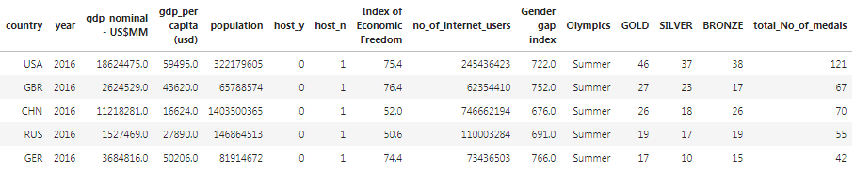
Regression Analysis
Variables that are used in regression are: Nominal GDP in US$, GDP per capita, Population, Gender Gap Index, No of internet users, Economic freedom index, Country is a host or not, Total medals.

Slide 15
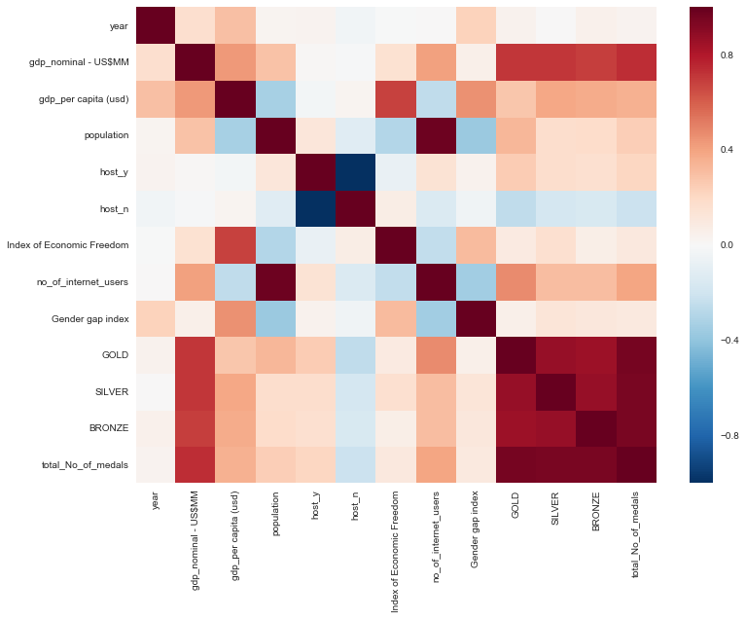
Correlation matrix between each variable.

Slide 16
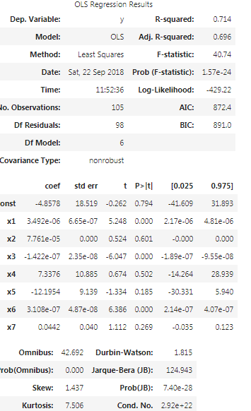
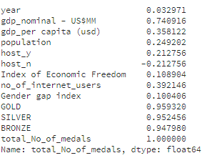
Backward Elimination Process for model selection.
CORRELATION of variables with total medals

Slide 17
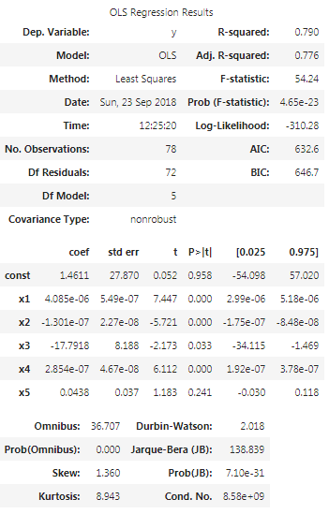
Final Model with constant term
The model has constant term. It shows that intercept is not significant and it is also making other variables insignificant. The intercept can be removed but it is kept to maintain the slope of the line and not forcefully fit it to pass through origin.

Slide 18
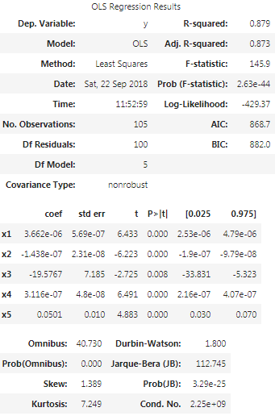
Model without constant term and forceful fit to regression line , passing through origin, all the predictors are significant.

Slide 19
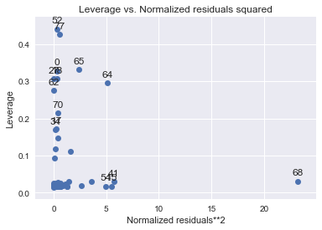
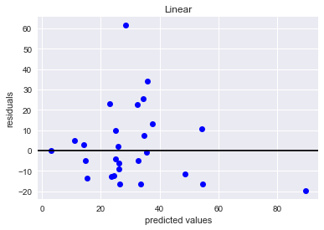
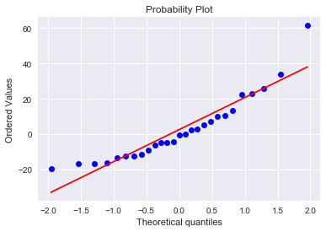
Regression Diagnostics
The first plot shows the plot of Leverage valuesand the observations with high leverage values.
The second plot shows plot of residuals and fitted values.
The third plot shows the Q-Q plot of the residuals

Slide 20
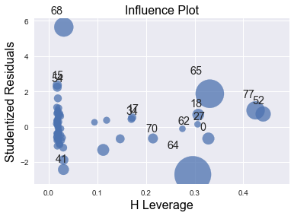
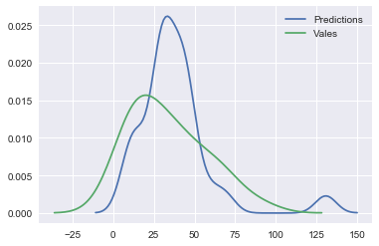
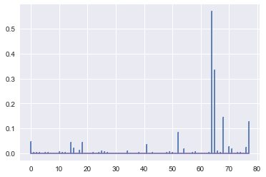
The first plot shows the Influential observations .
The second plot shows the
The third plot shows the Cook’s Distance and the values with abnormal cook’s distance.

Slide 21
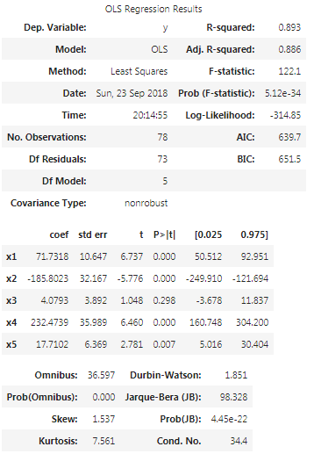
Scaling using min max scaler function is also performed and model is made using it.

Slide 22
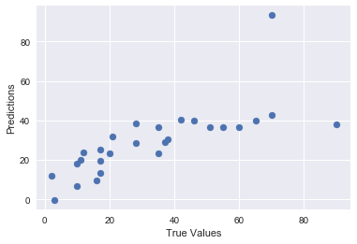
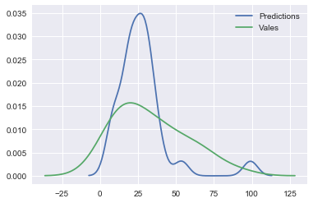
GBR – Gradient Boosting Regressor and Random Forest Regressor models are also used for regression analysis
Plot for GBR and Random Forest regressor

Slide 23
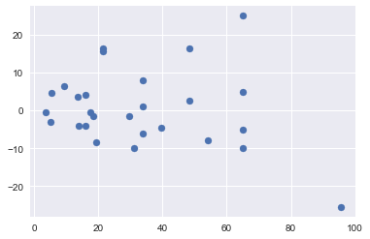
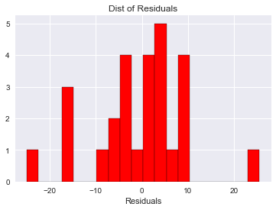
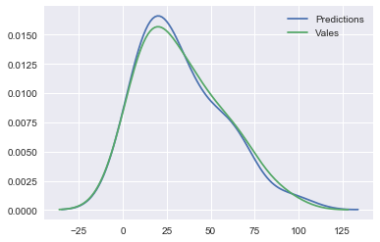
KNeighborsRegressor Model

Slide 24
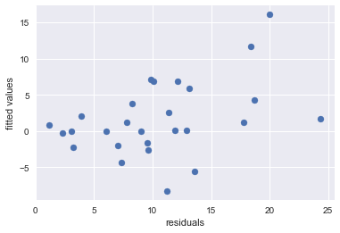
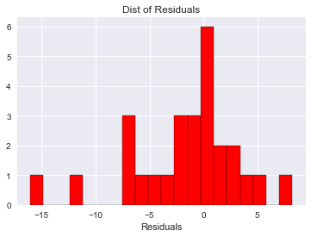
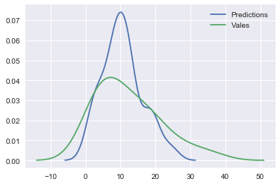
XGBOOST Regressor Model

Slide 25
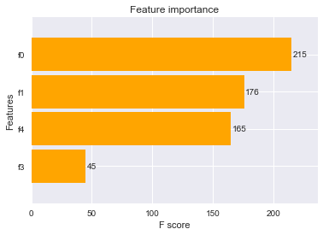
Features importance plot
Features importance plot using XG boost model. F- score has been compared for four features taken in this model.

Slide 26
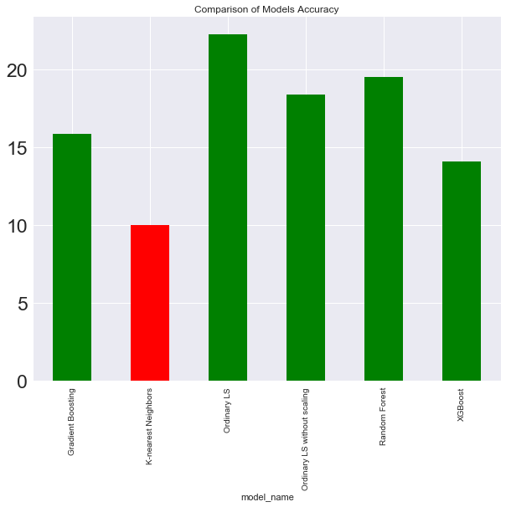
Comparison of Models Accuracy – RMSE of all the different models has been taken.
RMSE of K nearest Neighbour Regressor is least . So, it has been used for prediction

Slide 27
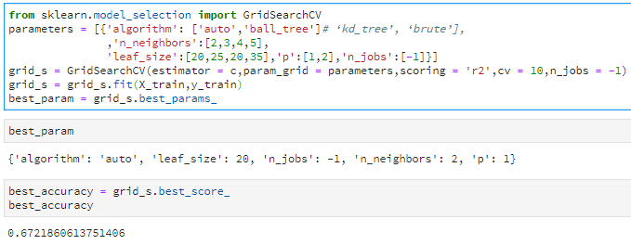
Grid search optimization method
Applying Grid search method #Optimization techniques. The method has been applied on KNN Regressor model. The parameters are chosen and are used for further analysis.

Slide 28
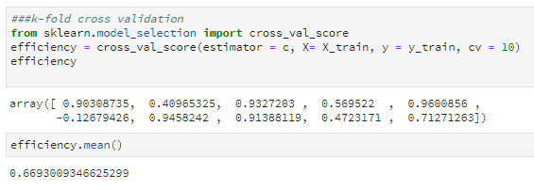
K – fold Cross validation
Here, 10 folds have been used to improve the score of the model.

Slide 29
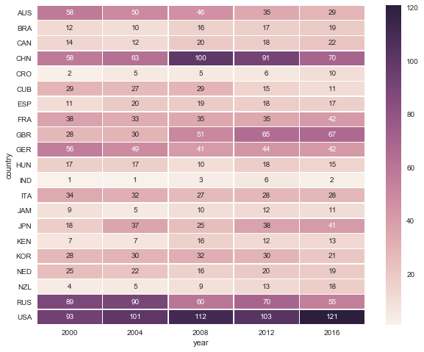
Heatmap of medals and country with year

Slide 30
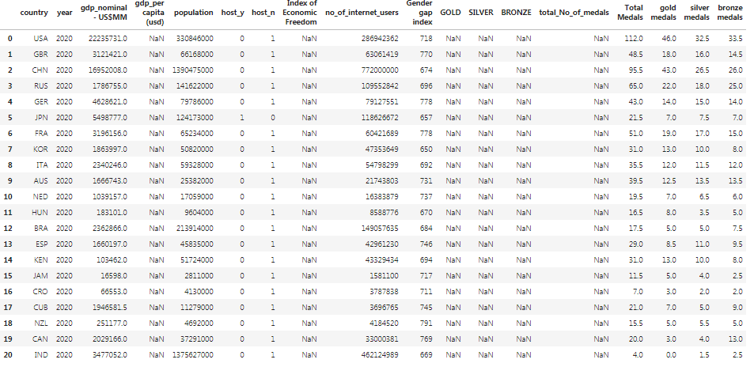
Final output of countries in 2020 olympics.

Slide 31
Rank in 2020 olympics
country
USA
GBR – Great Britain
CHN - china
RUS - russia
GER – Germany
JPN – japan
FRA - France
KOR - korea
ITA - Italy
AUS - Australia
NED - Netherlands
HUN – hungary
BRA - brazil
ESP - spain
KEN - Kenya
JAM - Jamaica
CRO - Croatia
CUB - cuba
NZL - new Zealand
CAN - Canada
IND – india not in top 20
Ranking
1
5
2
3
6
13
4
8
10
7
14
12
17
11
9
18
20
15
16
19

Slide 32
Analysis using K-means Clustering:
K- means clustering has been done using different set of variables.The primary dataset given has been used for this. The data was cleaned and then, only the players who have won medals are use in clustering.
Variables use for clustering - Age, Height, Weight.
This visual shows the loadings of Age, Height, Weight on the 3 new components(dimensions). PCA is performed in this. Height, Weight has high loadings on component 1. Age has high loading on Component 2 and Height, Weight has high loadings on Comp 3.

Slide 33
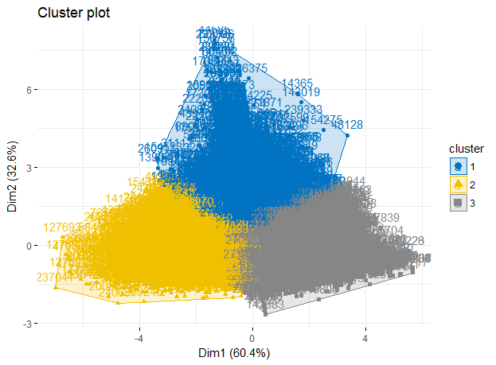

Histogram of close prices of all the four cryptocurrencies. All of them are following a standard normal curve

Slide 34
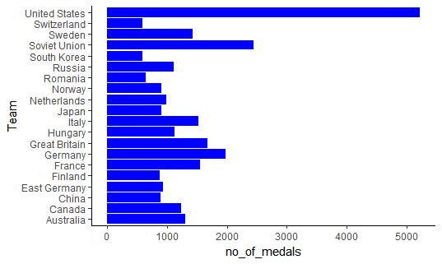
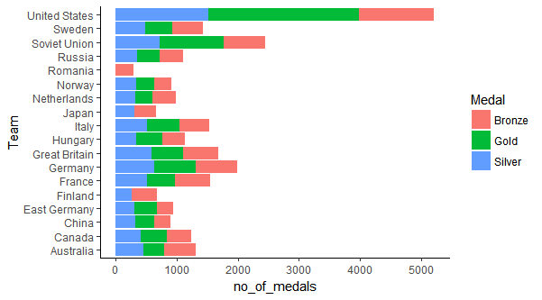

Slide 35
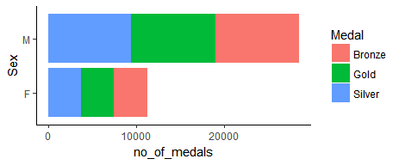

Slide 36
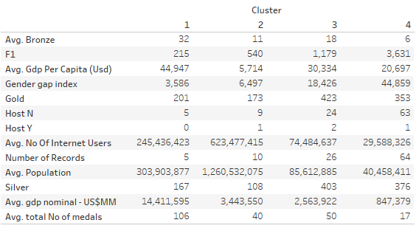
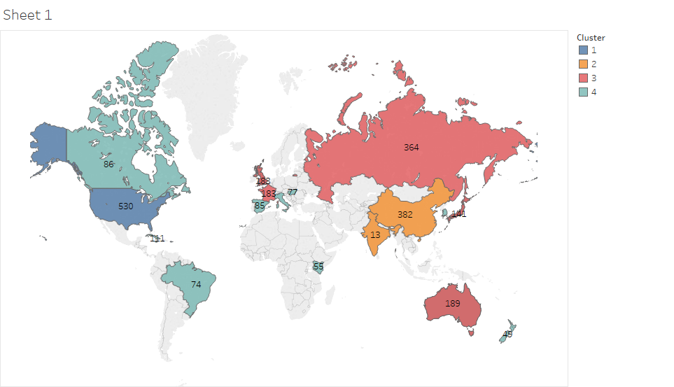
Clustering Countries using GDP-nominal, total medals and population.
The K means clustering is performed on GDP, population and Total medals variables. The dataset is the same that is used for regression analysis. Only years after – 2000 are considered and only top 20 ranked countries in 2016 summer olympics are taken Optimum no of clusters are 4 and most of the records are in cluster 4.
First cluster shows that it has highest number of bronze medals.Countries have highest GDP per capita
Second cluster has least Average GDP per capita, least number of silver and gold medals. Average population is very high and it consist of high populated countries.
3rd cluster has highest number of silver medals. Number of gold medals are also on the higher side. This cluster consist of US, china and top performing nations, teams
4th cluster shows that avg no of internet users are very less in this cluster. Most of the records are in this cluster but the no of medals are lesser as relative to other cluster.This cluster does not consist of top performing nations.

Slide 37
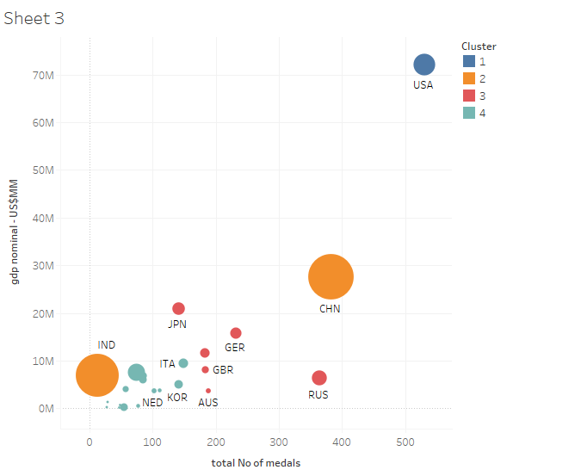
This chart is scatterplot, it shows relation between Nominal GDP and total count of medals for the same cluster as discussed just above. Cluster 1 contain only USA, Cluster 2 contain only China and India. Cluster 3 contain Russia, Germany , japan, Australia, GBR, Countries ranked from 10 to 20 in last summer Olympics come in 4th cluster. It clearly shows that both variables has some correlation with each other. USA is acting like an outlier in this chart.

Slide 38
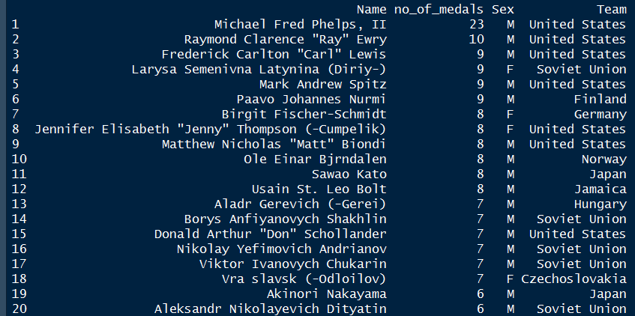
This chart shows the top 20 players according to the count of medals till now in the history of Olympics. Mostly the players are form US, Soviet Union, Japan, Germany. Michael Phelps is on the top because of the medals he won in swimming.

Slide 39
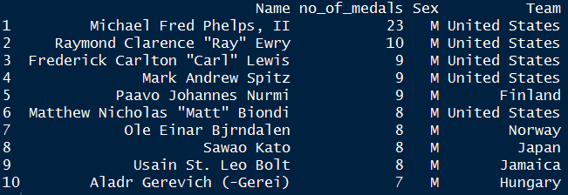
Top 10 Male athletes according to the number of medals, mostly from USA.
Top 10 female athletes according to the number of medals, mostly from Germany, US and soviet

Slide 40
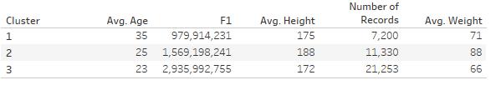
K means clustering on players who won medals in Summer and winter olympics.
The K- means clustering has been done for Winter and Summer olympics both . The optimum no of clusters are 3.
First cluster shows the average age is 35 and weight is 71. This cluster consist of experienced players and mature players who have won medals.
Second cluster shows the average age is 25 and weight is 88. This cluster consist of mixed players and it shows this the most suited combination of height, weight and age , which will secure more medals. Their height is also better relative to other clusters.
3rd cluster shows the average age is 23 and weight is 66. This cluster consist of younger players and might contain specific sports events , in which weight is important for players who have won medals. Their weight is very less as compared to other clusters

Slide 41

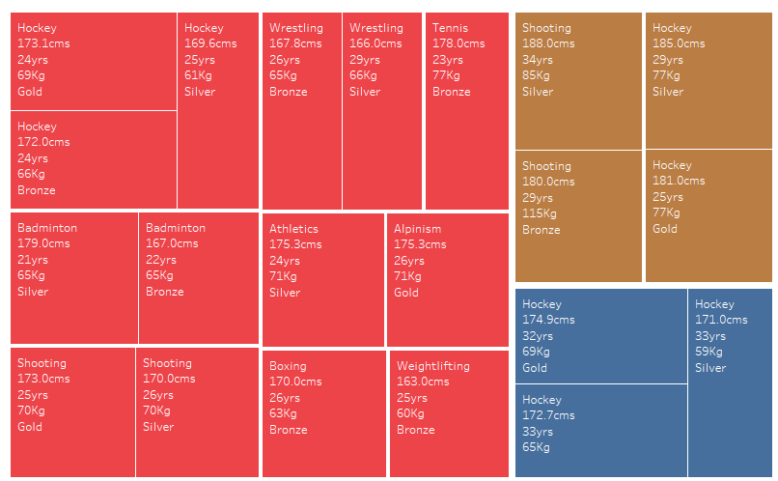
The treemap chart shows the genetic characteristics of the players in India who have won medals,
In hockey, weight is very less, and age is on higher or lower side. Some players have tall and have high weight.
In Badminton, weight is on the lowers side and age is also less. Youngsters can get more medals. Perfect age is 22 yrs.
In wrestling, age is 29 or 26 yrs, it proves that experienced persons are better in this sport and can get more medals.
Colour shows 3 different clusters . Most of players come in category of 3rd cluster who have won medals, Most of the hockey players come in 1st and 2nd cluster.

Slide 42
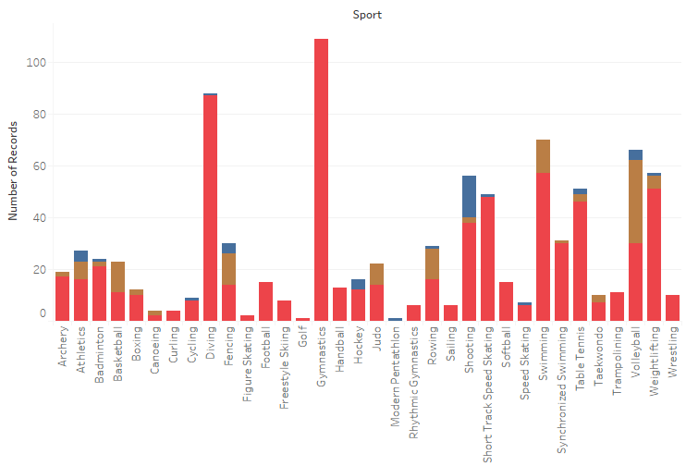
This Bar plot of all sports consist of players who have won medals, only from China country. China has huge medals in Diving, Gymnastics, Shooting, Skating, Table tennis, swimming, weightlifting and volleyball. These sports will be popular in sports schools in china and most of the players are from cluster 3 in gymnastics, diving, skating, weightlifting, badminton. This shows that all these sports need young players. This can be a lesson for Indian athletes to improve in these sports because India has lot of young sportspersons.

Slide 43
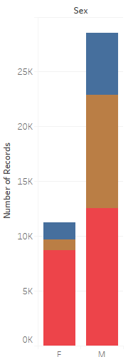
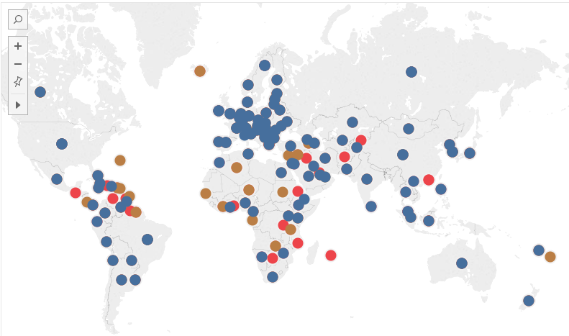
For summer olympics, this geo map chart shows the cities from where, the players belong and colour shows different clusters. Players from cluster 1 are spread across world. Players from cluster 2 are from Africa, middle east and asia regions and carribean countries.

Slide 44
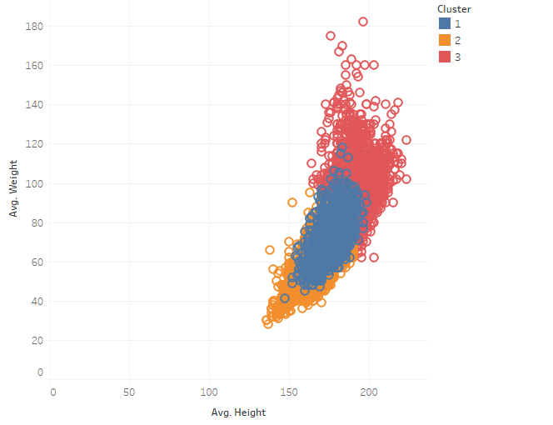
This is the scatter plot between avg weight and avg height, The clusters are shown by colours and it can be seen clearly from here that players in cluster 3 has weight, height on higher side and cluster 2 are having less average weight and height. Players in cluster 1 comes in middle

Slide 45
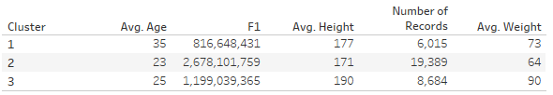
K means clustering on players who won medals in Summer olympics
Summer olympics
The K- means clustering has been done for Summer olympics. The optimum no of cluster are 3.
First cluster shows the average age is 35 and weight is 73. This cluster consist of experienced players and mature players who have won medals.
Second cluster shows the average age is 23 and weight is 64. This cluster consist of young players and it proves that lesser age and weight is the factor in getting more medals. This cluster has highest number of players.
3rd cluster shows the average age is 25 and weight is 90. This cluster consist of mixed players and might contain specific sports events , in which weight is important for players who have won medals. Their Average height is also highest , might consist of swimming players.

Slide 46
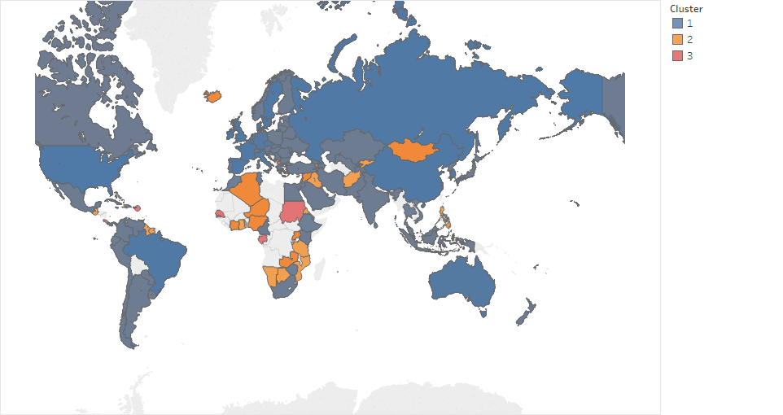
This geo- map chart shows different countries coloured by clusters of age, height and weight variables. It shows that cluster 2 – which has highest no of records and youngest players are mostly from Arab nations, African countries. Players in Cluster 1 are mostly from US, and big economy countries.

Slide 47
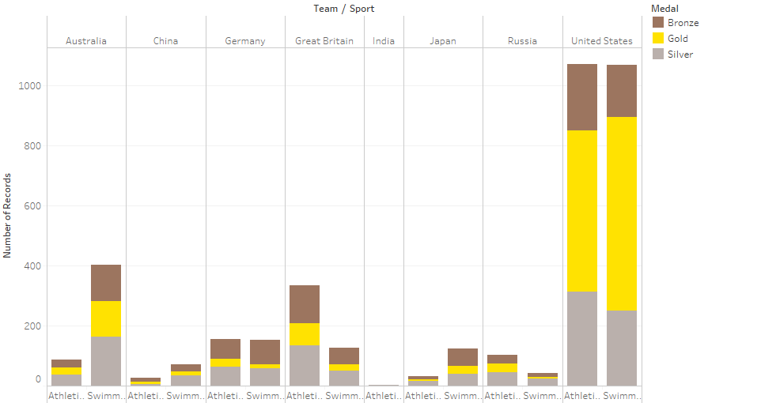
This chart shows the comparison only for Athletics and Swimming events in summer olympics cluster. This shows that USA and Aussies have highest number of medals in these 2 sports and it shows that the players genetic conditions are similar in these two countries. Great Britain and Germany also has good number of players in this.

Slide 48
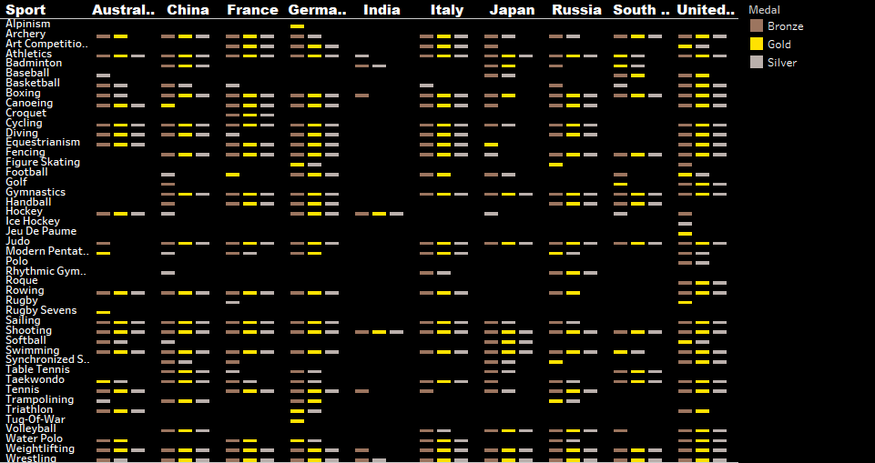

Slide 49
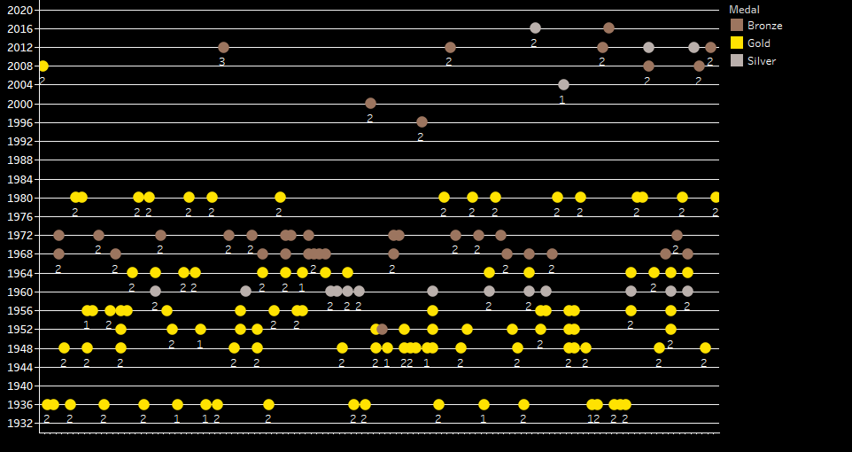
This chart compares the medals tally for summer olympics only for Indian team, it shows that Hockey was primary sport of India in earlier days but now, trend is changing to wrestling, badminton, boxing and shooting. Most of the players were younger or older in terms of age as most of the players are from cluster 1 and 2. In 2012 only, one player from cluster 3 won the bronze medal.

Slide 50
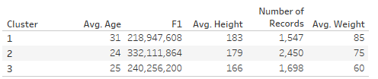
K means clustering on players who won medals in Winter olympics
The K- means clustering has been done for Winter olympics. The optimum no of cluster are 3.
First cluster shows the average age is 31 and weight is 85. This cluster consist of experienced players and mature players who have won medals.
Second cluster shows the average age is 24 and weight is 75. This cluster consist of mixed players and it shows this the most suited combination of height, weight and age , which will secure more medals.
3rd cluster shows the average age is 25 and weight is 60. This cluster consist of mixed players and might contain specific sports events , in which weight is important for players who have won medals. Their weight is very less as compared to other clusters

Slide 51
Modelling, evaluation
Root Mean Square error is used. Assumptions of Linear regression are tested for evaluation of model.
Models are evalueated using K – fold cross validation and residuals plot and optimized using Grid search method.

Slide 52
Business Recommendation
Forecasting model for medals can be made using Neural Network.
The OPTIMIZATION TECHNIQUES can be used for optimizing the model.
The data for more countries can be taken to make model more robust.

Slide 53
Assumptions, Limitations:
The data was collected for only 5 years from 2000 to 2016.
The data used for regression was small and the sample contains only 20 countries data.
Not able to collect data related to Sports centres, sports funding for countries.
The test data for year 2020 was not available for all fields. So, data for 2018 year is considered.
The features in dataset are not normal.
Assumptions of Multiple Regression are used in modelling

Slide 54
References
https://en.wikipedia.org/wiki/Olympic_Games
https://en.wikipedia.org/wiki/List_of_countries_by_number_of_Internet_users
https://data.worldbank.org/indicator/ny.gdp.pcap.pp.cd
https://www.heritage.org/index/ranking

